Slide 1
Assignment 1.2 Charts
DSC640
Taniya Adhikari

Slide 2
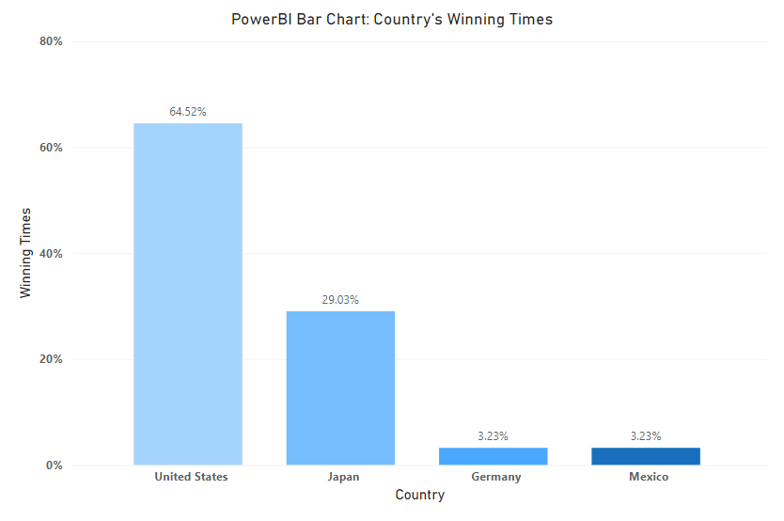
PowerBI – Bar Chart

Slide 3
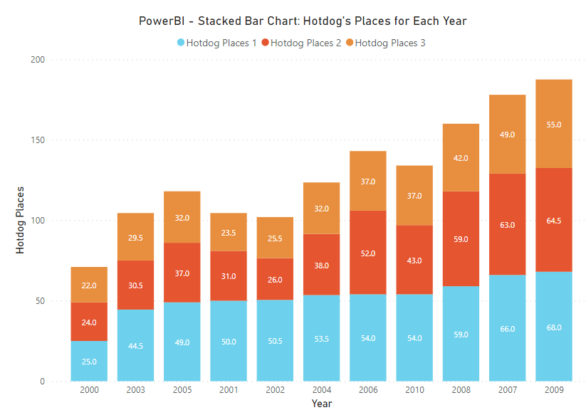
PowerBI – Stacked Bar Chart

Slide 4
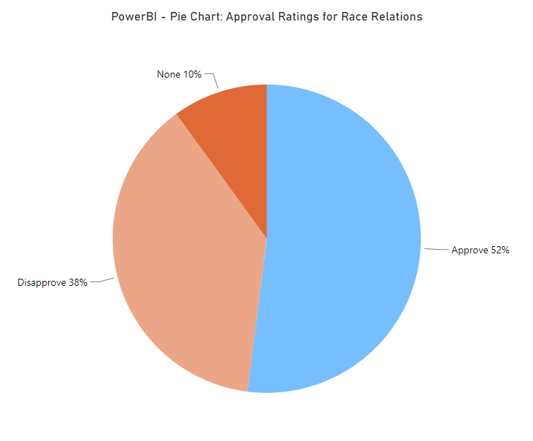
PowerBI – Pie Chart

Slide 5
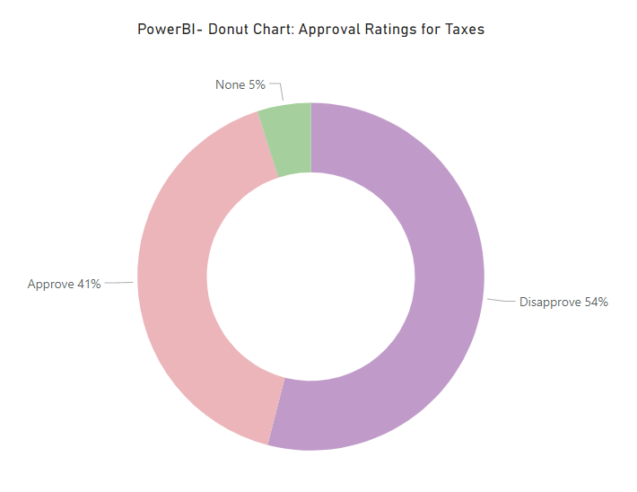
PowerBI – Donut Chart

Slide 6
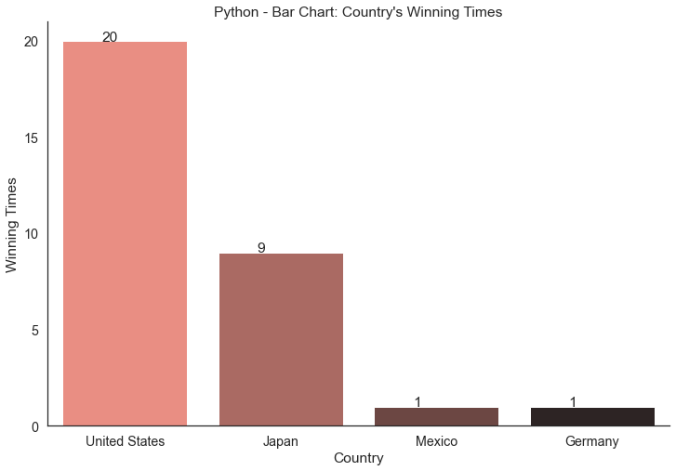
Python – Bar Chart

Slide 7
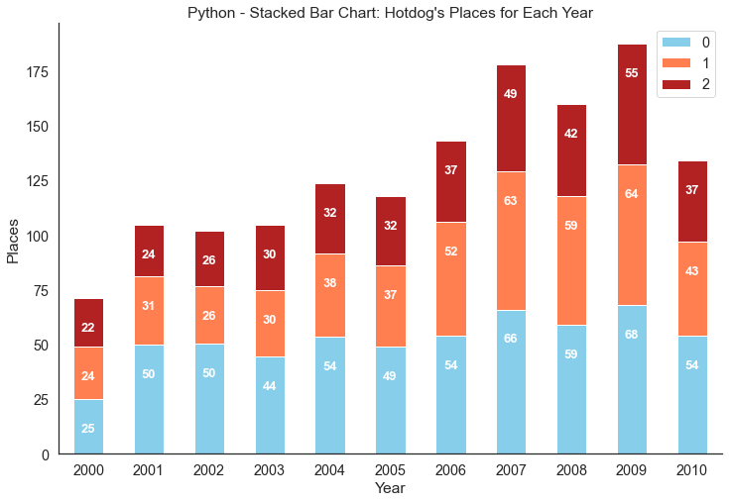
Python – Stacked Bar Chart

Slide 8
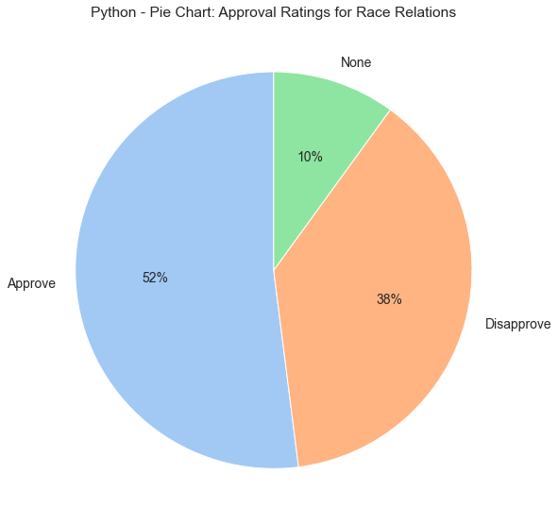
Python – Pie Chart

Slide 9
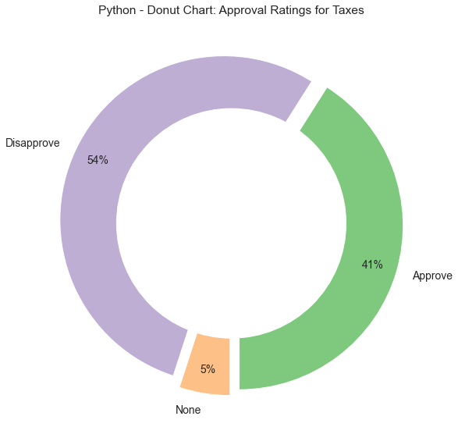
Python – Donut Chart

Slide 10
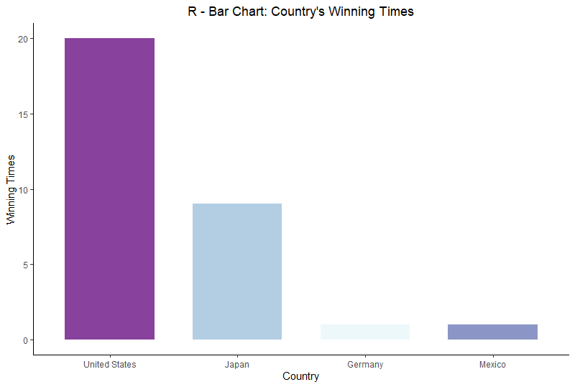
R – Bar Chart

Slide 11
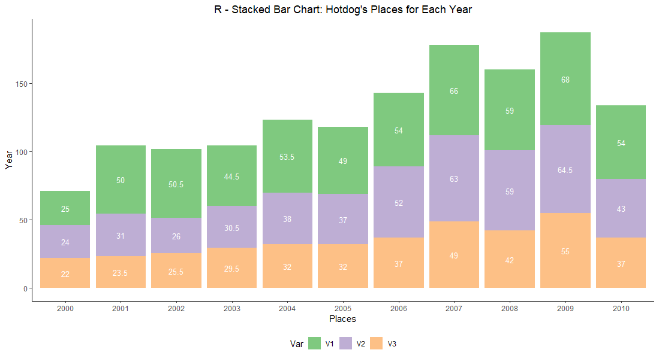
R – Stacked Bar Chart

Slide 12
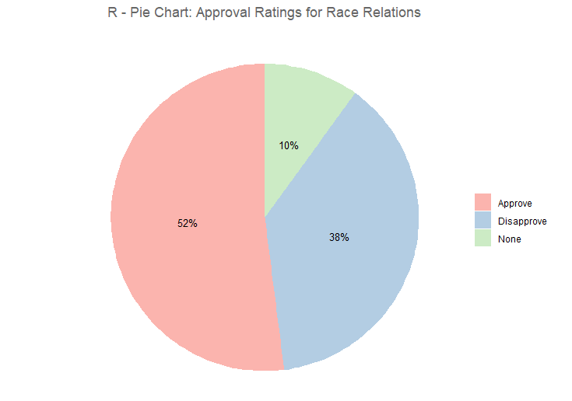
R – Pie Chart

Slide 13
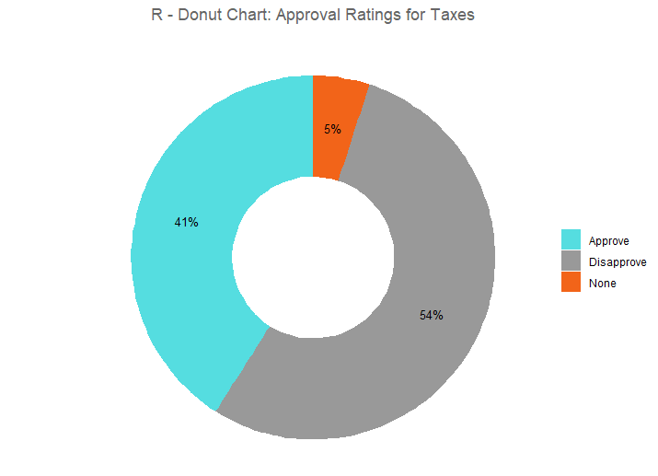
R – Donut Chart

Slide 14
Supplemental Files
Python Code
R Code
PowerBI File

